Slide 1
Java and Object Oriented Programming
Splash 2014, Ryan Jerue and Marco Crippa

Slide 2

What’s a Java?
Programming Language
Great for beginners because of a powerful API
Runs in a Virtual Machine
Compiles into ByteCode
Can be run anywhere that a Java Virtual Machine (aka the JVM) is written
One of the most “popular” languages

Slide 3
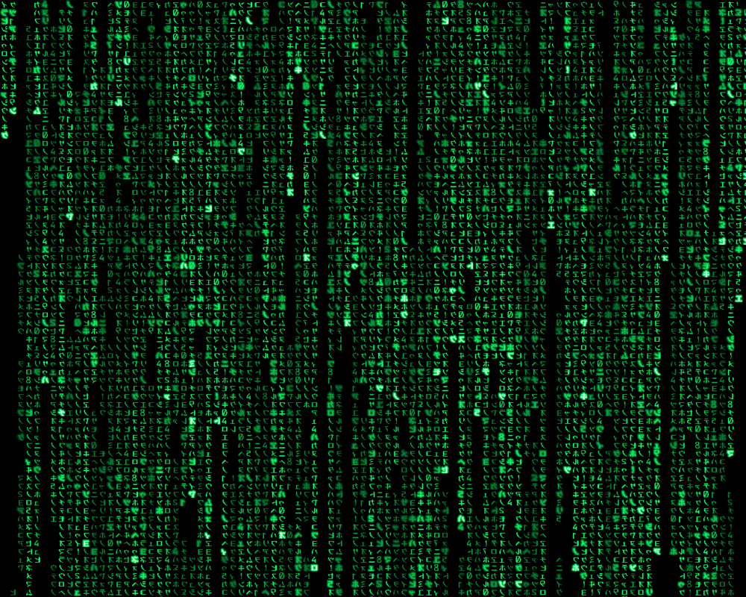
Data Types
Numbers
int – An integer (-1, 0, 1, 2, 3, 42)
double – A complex number (-1.1, 0.12, 1.1, 3.14)
Words
char –Single Character (‘a’, ‘b’, ‘c’, ‘!’, ‘7’)
String –Many Characters(“I love my doge”).
Booleans
True or False
Arrays are a collection of data.
A word on Strings:
Strings in many programming languages are known as an array of characters, in Java a String is treated as its own object

Slide 4

Wait, what on Earth is an Object?
Something…
No really, anything with properties.
Properties can be primitives, or other objects!
Think of YOU as an Object
String Name
int age
double height
boolean isAlive

Slide 5
Let’s Play with some Code!
Go open eclipse!

Slide 6
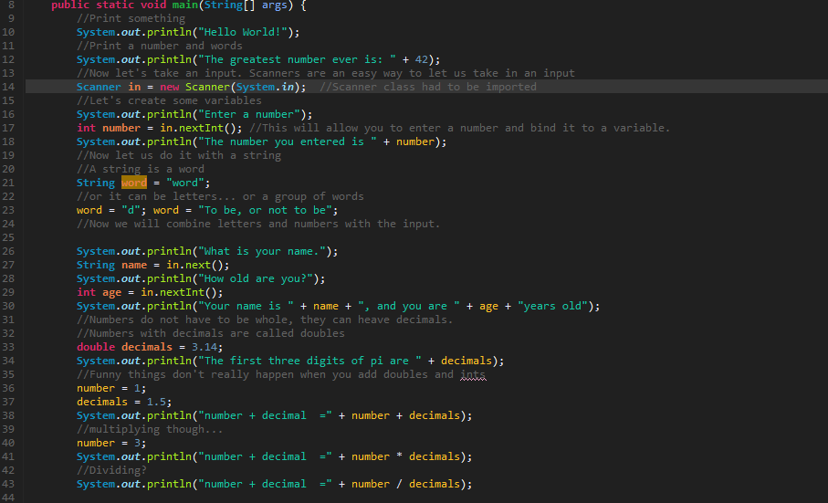

Slide 7
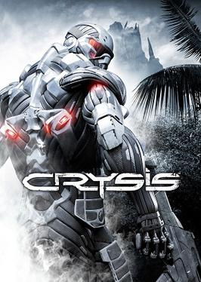
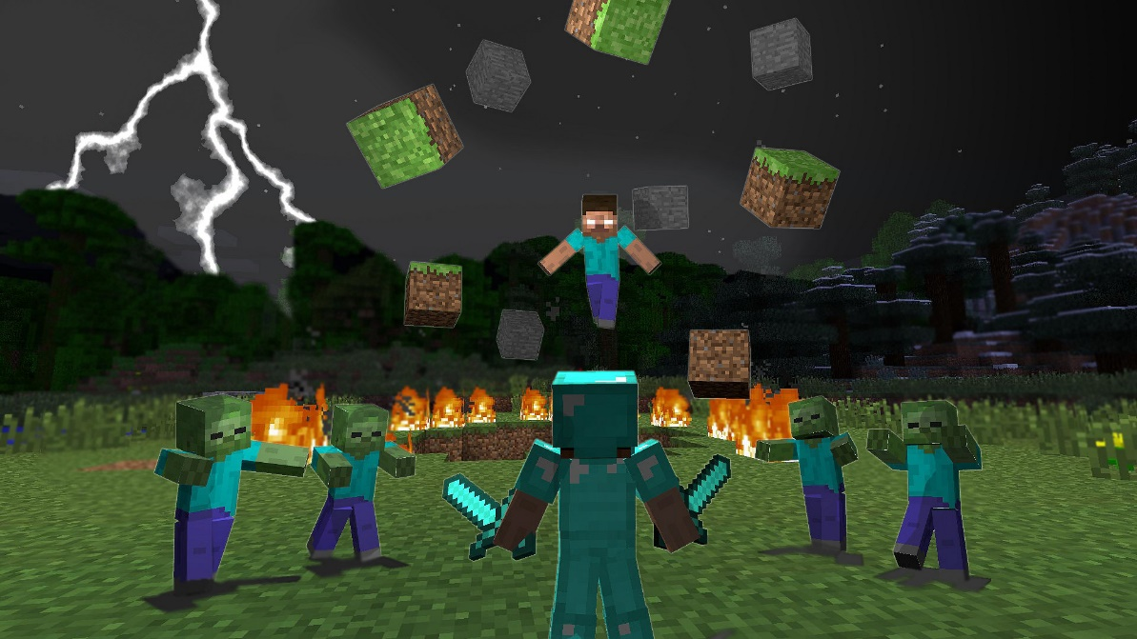
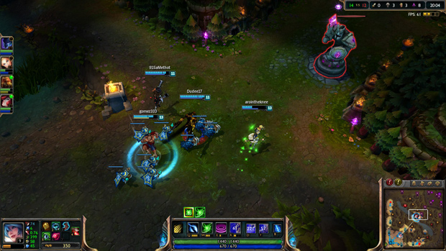
“GoJava” the game
A small case study

Slide 8
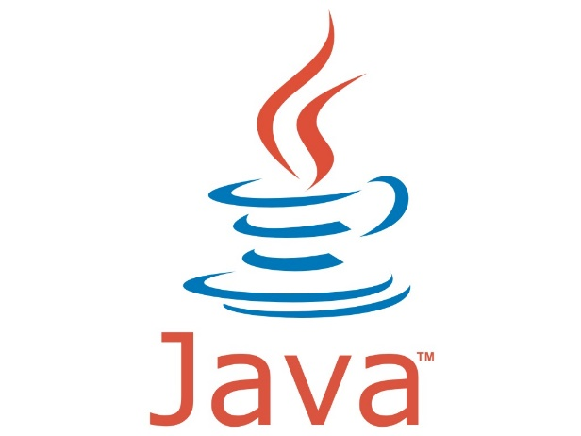
Rules of the game
40 Cards in the deck
4 Suits
Number of 0-9
Deck is Shuffled
Each player draws 10 cards
Each player guesses a card that the other one has
First player to guess 5 Cards wins.

Slide 9
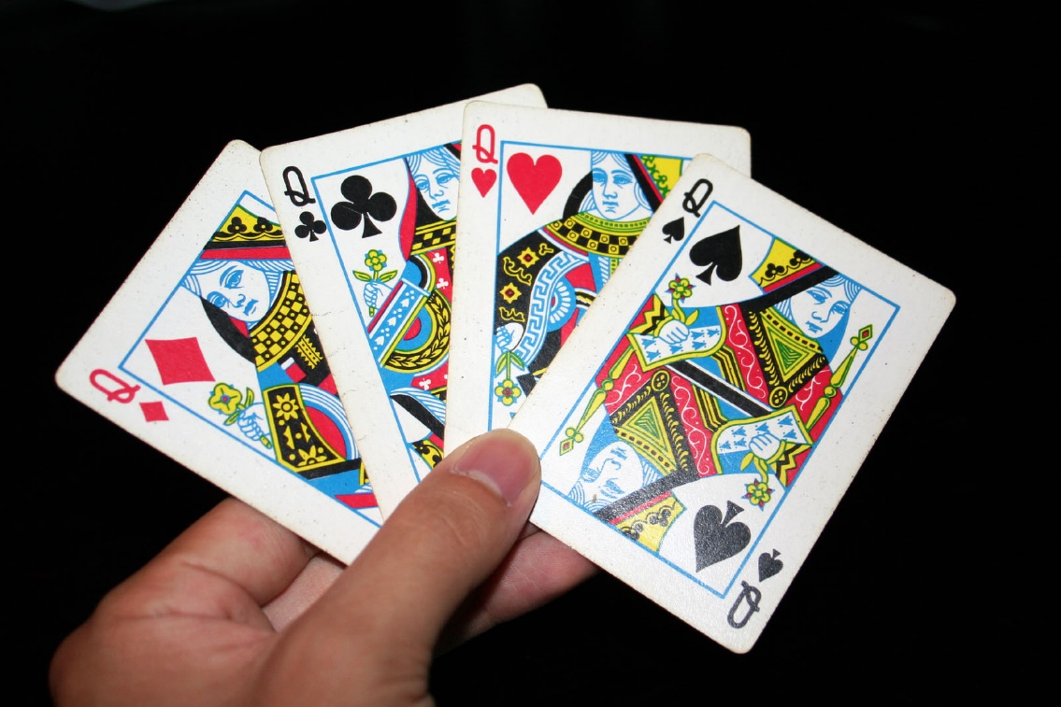
Thinking in Objects
What Properties Does a Card Have?
Suit
Value
Is it flipped over?
What can you do to a card?
Flip it over

Slide 10
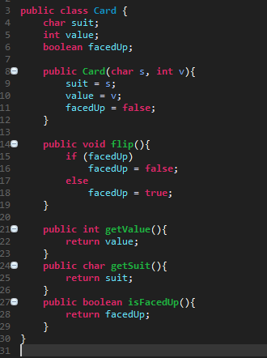

Slide 11

Now let’s make the game
Makes the deck
Draws Cards
Loop
Player One Goes
Check if he wins
Player Two Goes
Check if he wins
Display winner

